Slide 1
MCMA 962 - Engaging The Online Learner
Pressbook urls, and a Lessons Learned Guide (Administration Documents, PPTs, Tips and Recommendations from the pilot delivery)

Slide 2
Pressbooks
French and English URLs

Slide 3
EN https://ecampusontario.pressbooks.pub/engagingtheonlinelearner/

Slide 4
FR
https://ecampusontario.pressbooks.pub/impliquerlesapprenantsenligne/

Slide 5
Lessons Learned Guide
Administrative Documents, PPTs, Tips and Recommendations from the pilot delivery

Slide 6
Contents
Item | slide(s)
Sample of Pre-delivery Communication | 7 - 8
Sample Rubric | 9
Sample Digital Badge | 10
Link to the Evaluation Form | 11
Link to Facilitators’ PowerPoints/Slides | 12
Summary of Feedback and Tips and Recommendations from the pilot delivery | 13 - 15

Slide 7
Sample of a Facilitator Welcome Message (French)

Slide 8
Sample of Instructor- Student Communication (English)
< > is your session leader.
The workshops require you to join a Zoom meeting by clicking the following link: < >
You will also be required to log into Pressbooks: < >
Please join the Zoom meeting 10 minutes prior to the scheduled time, so that any housekeeping and/or technical questions can be addressed.
Your support contact for the sessions are < > . This contact can be reached before and during the workshop a t < > for Zoom support and/or other readiness support, if required.
NOTE: You will NOT require a password or a login code to join the session. Your learning experience will be enhanced by your participation by using a variety of Zoom tools during the sessions and by completing activities, tasks and requirements.

Slide 9
 | Excellent/ Digital Badge earned | Not successful/Didn’t complete requirements to obtain a Digital Badge
Helped build community and participate as part of a group | Often presented reflections that were central to the group’s discussion; interacted freely and encouraged or made space for others’ input. Consistently presented reflections on topic; knowledge gained was incorporated into responses. Showed a willingness to utilize/demonstrate strategies to address learner engagement challenges and to offer options to the group. | Not actively involved in the sessions. Didn’t attend or complete tasks, or provide feedback required. Poor or unsatisfactory attendance (less than 50%) and/ or marginal effort to become involved with providing options to the group.
Synthesis and evaluation of learner’s learning/ use of language | Validated reflection of their learning. Showed use of topic language in a meaningful way. | Failed to demonstrate reflection of their learning. Showed little or no use of topic language.
Task Requirements (set by the facilitator and/ or negotiated by the group) | Completed and/or helped to guide tasks and assessment criteria. Completed course evaluation. | Serious lack of performing the task requirements.
Sample Rubric (English)

Slide 10
Sample Badge (English)

Slide 11
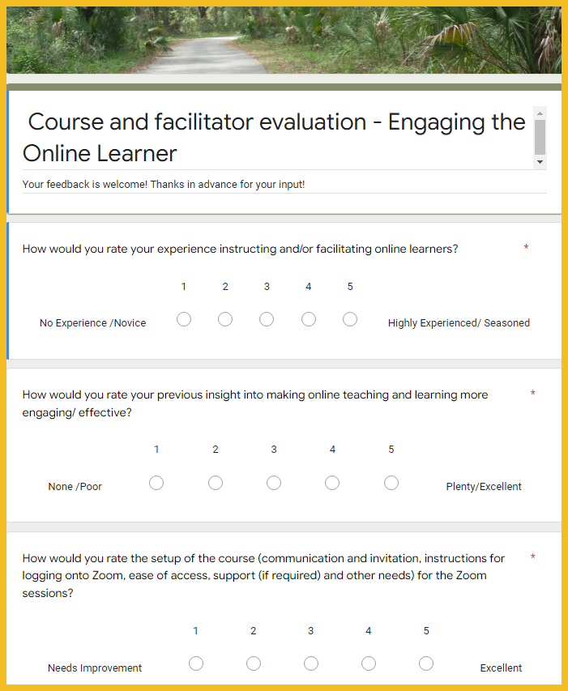
Sample Evaluation (English)
Google Form

Slide 12
Link to Facilitators’ PowerPoints
PPTS (French 1)
PPTS (French 2)
PPTS (English 1 - 4)

Slide 13
Tips and Recommendations
Pressbooks is an effective tool for sharing accessible content and activities. The project team employed a variety of content treatments to leverage the research which was selected to anchor our topic. We referenced material and provided links to short videos, links to external resources, and employed H5Ps to help add some variety and encourage exploration. The project was not designed for delivery on a Learning Management System (LMS). Pressbooks has a natural book format which requires facilitation in order to help illustrate possibilities.
Our strategy was to pilot the Pressbooks material via Zoom to English and French language cohorts. The delivery started in February 2022 and was completed in March 2022. The Zoom facilitation option required securing competent facilitators (proficient teaching with Zoom or other real time communication software and qualified in the subject matter). Facilitators were expected to develop a Lesson Plan and PowerPoints that interfaced with the Pressbook content. Recommendations for delivery (based on our pilot) and summary of the feedback from the pilot is shared in Appendix 1. The use of lesson plans would help with the structuring and the pacing of individual and group activities aligned with the course objectives during the synchronous sessions. No lesson plans are included in this package. Learners were expected to complete activities, requirements, attend sessions and provide feedback in order to receive the digital badge.

Slide 14
Tips and Recommendations (Continued)
Here’s a summary of Lessons Learned from this experience:
Activities were instrumental for engaging students and helping them build assets for their potential use (examples: creation of a video welcome, creation and/or use of an icebreaker, reflection on practice);
Facilitation using Zoom (or another real time communication tool) was beneficial;
The session length and schedule can add to the experience (rapport building);
Pressbooks assets should be finalized prior to ‘pilot’ delivery;
Good facilitation skills were critical to the success of the delivery;
The project team leaned on McMaster University’s stated request to respect principles of equity, decolonization, diversity and inclusion to add value to the product/experience.
Please contact Dan Piedra, McMaster University or Mike Harttrup, learnitanywhere inc. with any questions that you may have.

Slide 15
 | English Delivery | French Delivery | Recommendations for Delivery
Delivery Schedule | Tuesdays (4pm- 5pm) over 4 weeks | Weekdays (4pm - 6pm) X 2 weeks | TBD
Length of Time per Session | 1 hour | 2 hours | Between 1 and 2 hours
Number of Engagement Tasks (During the Session) | Between 3 - 5 activities per each session | Varies/ Reflection and Review activities per each session | TBD
Time Required to complete Group/ Individual Tasks (Outside of Session) | 1 - 2 hours | 1 - 2 hours | 1 - 2 hours
Number of Participants in the Cohort | 5 - 6 | 5 - 6 | TBD
Use of Zoom (or other Real time Communication) to Compliment Pressbooks | Recommended | Recommended | Recommended
Preparation time for Zoom facilitators | Approximately 20 hours | Approximately 20 hours | Approximately 20 hours
Post-delivery feedback summary
Overall Pressbooks Content | 3 (Good) | 3 (Good) | TBD
Overall Facilitator and Zoom experience | 4 - 5 (Very Good to Excellent) | 5 (Excellent) | TBD
Appendix 1

