Slide 1
Introduction to Scholarly Publishing for College Faculty
Kyle Montgomery, MLIS
Marnie Seal, MLIS
Cambrian College Library

Slide 2
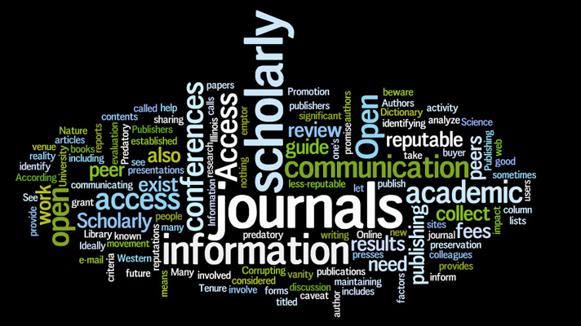
Outline
Journal publishing process
Publishing resources/tools
Writing guides
Selecting a journal
Assessing journal attributes
Assessing author metrics
Peer review process
Publishing fees & APCs
Creating ‘alerts’ for a given topic of interest

Slide 3
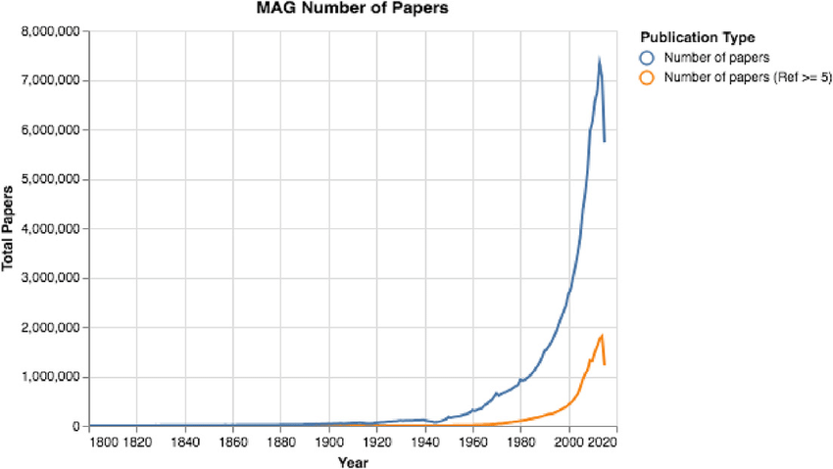
Introduction
Publishing, scholarly communication ignited by an original idea
A common format, published journal article
In 2014, estimate > 7 million peer-reviewed published articles (Fire, 2019)
A focused purpose
Framed in accordance with a systematic process
Notes:
https://www.researchgate.net/figure/The-number-of-papers-over-time-The-total-number-of-papers-has-surged-exponentially-over_fig1_333487946

Slide 4
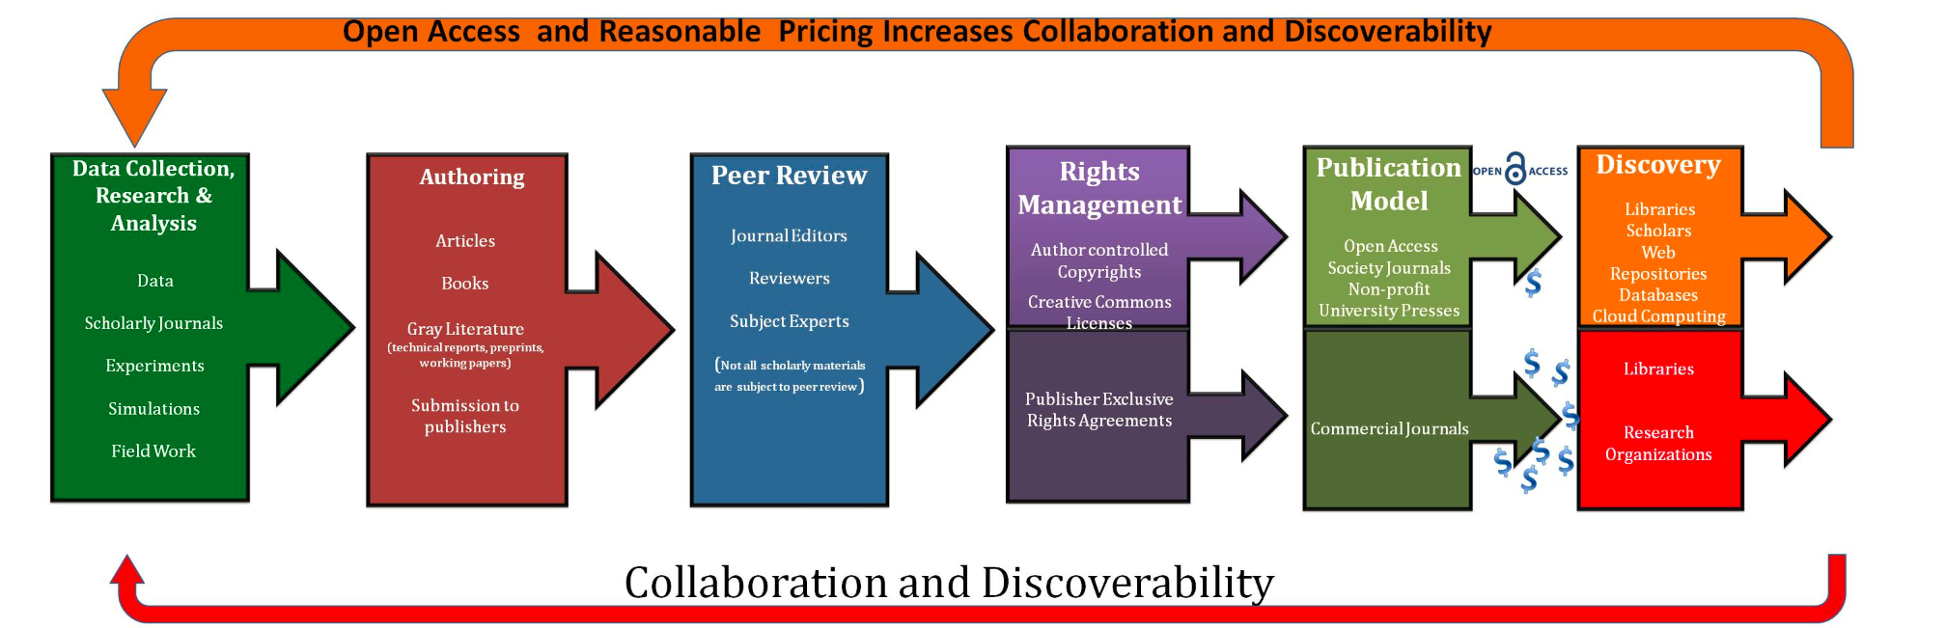
Publishing steps
A series of steps beginning with exploration of a novel idea
A perspective, the life cycle model of publishing which is underpinned by collaboration and knowledge discoverability
Note the following model, delineates steps between ‘authoring,’ scholarly partnerships, to disseminating knowledge

Slide 5
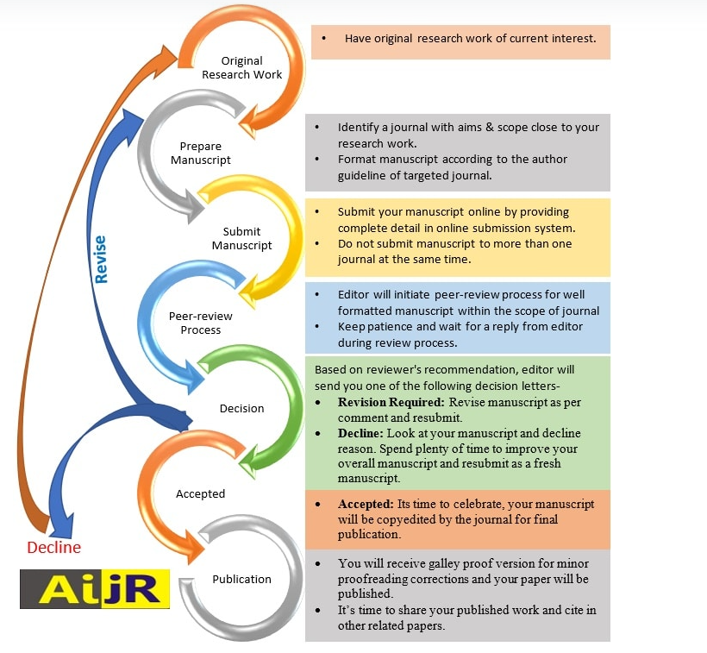
From the perspective a publisher, another conceptualization of publishing (AIJR)
Notes:
AIJR is an international scholarly publisher dedicated to providing the best possible open access publishing service to the academia & research community. We help authors to publish & share their discoveries, enable researchers to find, access, and understand the work of others, and support librarians and institutions with an authoritative source of scholarly content. Our goal is to expand the boundaries of knowledge for the benefit of humanity as open science can benefit research and society. We are committed to promoting the integrity of research by focusing on the issues that matter to the research community, standing up for science, advocating open research, and strongly supporting the highest quality and ethical standards in research.

Slide 6
Preparing a journal article
Iterative steps (Table 1) similar across knowledge disciplines (Busse & August, 2021; Gastel & Day, 2016; Ortinau, 2011)
Table 1 Publishing steps identified by various authors
Publication steps | Components
Conceptualizing and writing | Informative and inviting article title Authorship and roles Thesis/purpose Present a credible, logical, compelling narrative Incorporate a style guide (eg. APA)
Selecting a journal | Journal’s scope and purpose Intended audience and geography Acceptable formats/conventions Following author guidelines Adherence to submission guidelines
Recognizing rights & permission | Copyright
Understanding the journal’s review process | Functions of editors & peer reviewers Relevance and logical presentation Editor’s decision to accept, revise, or reject article based on reviewers’ appraisal Meaningful and respectful responses to reviewers’ comments Detailed response letter to reviewers/editor
Copyediting and proofing | Proofs sent to authors Marking corrections Reprints

Slide 7
Writing resources
Readily available textbooks at Cambrian College
General texts
Lead Author (Year) | Title | Publisher | Intended Audience | WorldCat Link
Bond, J. (2022) | The Little Guide to Getting Your Journal Article Published | Rowman & Littlefield | Novice or uncertain authors | https://www.worldcat.org/title/1111952681
Gaillet, L. (2015) | Primary Research and Writing | Routledge | Graduates beginning their academic writing careers | https://www.worldcat.org/title/1111952681
Maree, K. (2012) | First steps in journal article writing | Juta | Novice & experienced researchers | https://www.worldcat.org/title/1111952681

Slide 8
Style Guides
Lead Author (Year) | Title | Publisher | Intended Audience | WorldCat Link
American Psychological Association (2020) | Publication manual of the American Psychological Association: the official guide to APA style | American Psychological Association | Writers, researchers, editors, students, and educators in the social and behavioral sciences, natural sciences, nursing, communications, education, business, engineering | https://www.worldcat.org/title/1111952681
Cooper, H. (2020) | Reporting quantitative research in psychology: how to meet APA style journal article reporting standards | American Psychological Association | Authors implementing the American Psychological Association's Journal Article Reporting Standards for Quantitative Research | https://www.worldcat.org/title/1111952681

Slide 9
Guides specific to disciplines of knowledge
Lead Author (Year) | Title | Publisher | Intended Audience | WorldCat Link
Markovac, J. (2018) | Medical and Scientific Publishing; Author, Editor, and Reviewer Perspectives | Academic Press | Medical students, doctors, scientists | https://www.worldcat.org/title/1011356908
Gutman, S. (2017) | Journal Article Writing and Publication: Your Guide to Mastering Clinical Health Care Reporting Standards | Slack Inc. | Health care educators & novice researchers | https://www.worldcat.org/title/1111952681
Patience, G. (2015) | Communicate Science Papers, Presentations, and Posters Effectively | Academic Press | Professors, students & professionals in science, technology, engineering & mathematical fields | https://www.worldcat.org/title/1111952681

Slide 10
Selecting a journal
When selecting a journal to submit your manuscript to, consider the following steps:
Review lists of academic journals:
Cambrian College Publication Database
WorldCat
Ulrichsweb.com
Directory of Open Access Journals (DOAJ)
Recommend visiting specific journal’s website to identify its policies, credentials of the editorial board, scope or aims

Slide 11
Selecting a Journal
Identify a potential journal based on drafted article’s title and abstract:
Publisher specific [Elsevier Journal Finder; Institution of Electric and Electronic Engineers [IEEE ] Publication Recommender; Manuscript Matcher; Springer Journal Suggester; Wiley]
PubMed specific [JANE – Journal/Author Name Estimator]
Generic search tools [Journal Guide; Open Access Journal Finder by Enago]

Slide 12
Assessing journal attributes
a. Here are some tools you can use to establish criteria to determine the quality of identified academic journal:
How to Assess a Journal according to the Canadian Association of Research Library
Beall’s List of predatory open-access publishers
Think Check Submit, a submission checklist
Committee of Publication Ethics (COPE) guidelines, a publisher’s adherence to ethical criteria [eg. transparency, consent*]
*If conducting research involving human participants, please visit Cambrian College’s Research Ethics protocol

Slide 13
b. Review the selected journal’s metrics:
Metrics refer to the journal’s “impact” or level of influence in the subject area over a period of time
Several tools available based on different factors [eg. number of citations, total annual number of publications]
Journal impact formulas can be found here
Scimago Journal & Country Rank
Eigen factor
Journal Citation Reports
Impact Factor
Source Normalized Impact per Paper
Impact Per Publication
Determining the most appropriate tool is relative to the discipline
A caveat, authors not view the impact metric as the only indicator of journal quality

Slide 14
c. To understand the impact of an individual article within a specific journal, the following metrics may be included:
Altmetric.com
PlumX Metrics
Google Scholar
Web of Science
Scopus
Crossref.org
Highwire
Nature Publishing Group

Slide 15
Assessing author metrics
h-index is a metric based on an author’s number of publications and citations
Tools available to reveal an author’s metric:
Impactstory
Publish or Perish
ORCID
Research Gate Score
Google Scholar Profiles

Slide 16
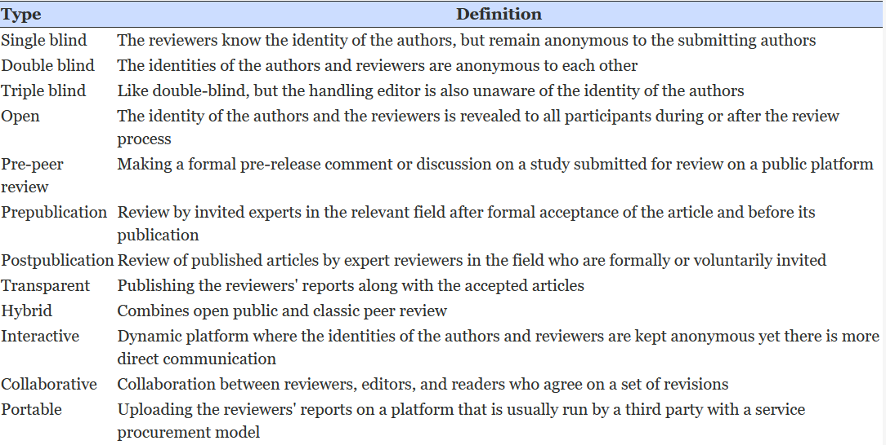
Peer review process
Each journal outlines its peer review process
Variation in peer review process is not necessarily problematic as shaped by journal’s aim
Examples of peer review processes (Emile et al., 2022)

Slide 17
Publishing Fees & APCs
Article Processing Charges (APCs) are charged to authors of scholarly articles during the publication process
Paying an APC results in an article that is available to anyone
APCs shift the burden of journal production costs from readers to authors
APCs are often used by open access journals in lieu of subscription fees
APCs commonly use 2 models
Gold: open access journals make articles free for readers, but charge authors
Hybrid journals: subscription-based allow for authors the to make their article open access for a fee. (UNLV Libraries, 2023, Ontario Tech Library, 2023)
For more information on journal income models, see Income Models For Open Access: An Overview of Current Practice (SPARC, 2009) and Business Models for Journals (Open Access Network, 2023)

Slide 18
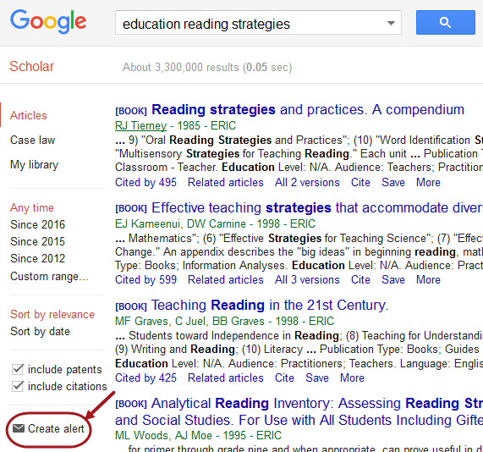
Creating ‘alerts’ given topic of interest
Alerts are automatic e-mail notifications that will inform you of any newly published articles matching a set of criteria
Alerts automatically track newly published research in your field to help you stay up-to-date on newly published literature
The process of setting up alerts are database specific

Slide 19
Creating ‘alerts’ given topic of interest
Procedures to create alerts for other specific databases can be found here:
Google Scholar
EBSCO
ProQuest databases
OVID MEDLINE alerts
Pubmed

Slide 20
Questions
Look forward to further discussions
Cambrian College Library:
Drop-in
Email: library@cambriancollege.ca
Phone: (705) 566-8101 ext. 7333

Slide 21
Works Cited
Busse, C., & August, E. (2021). How to Write and Publish a Research Paper for a Peer-Reviewed Journal. Journal of cancer education : the official journal of the American Association for Cancer Education, 36(5), 909–913. https://doi.org/10.1007/s13187-020-01751-z
Gastel, C. & Day, R. A. (2016). How to Write and Publish a Scientific Paper (8th ed.). Greenwood.
Ortinau, D. J. (2011). Writing and publishing important scientific articles: A reviewer's perspective. Journal of Business Research 65(2), 150-156. https://doi.org/10.1016/j.jbusres.2010.02.002.
Emile, S. H., Hamid, H. K. S., Atici, S. D., Kosker, D. N., Papa, M. V., Elfeki, H., Tan, C. Y., El-Hussuna, A.; Wexner, S. D. (2021). Types, limitations, and possible alternatives of peer review based on the literature and surgeons’ opinions via Twitter: a narrative review. Science Editing 9(1), 3-14. https://doi.org/10.6087/kcse.257

Slide 22
Image Credits
http://www.wiu.edu/libraries/news/2010s/2017/scholarlycommunication101.php
https://library.georgiancollege.ca/c.php?g=506178&p=3500603
https://academicanswers.waldenu.edu/faq/134432

