Slide 1
Week 10: Evaluating eLearning Artifacts: Principles & Frameworks
EDST 3440U: Managing and Developing eLearning Projects

Slide 2
Land Acknowledgement
Ontario Tech acknowledges the lands of the people of the Mississaugas of Scugog Island First Nations. We are situated within the traditional territory of the Mississauga and in the territory covered by the Williams Treaties. We are grateful to enjoy and learn on these lands.
For more information on Land Acknowledgements, please visit the Ontario Tech Land Acknowledgement webpage.
To know what land you reside on, please visit https://www.whose.land/en/.

Slide 3
Class Overview
Welcome
Land Acknowledgement
Assignment 3 Discussion
Evaluating eLearning Artifacts: Principles & Frameworks
Breakout Rooms
Wrap Up

Slide 4
Assignment 3 Discussion

Slide 5
Evaluating eLearning Artifacts: Principles & Frameworks

Slide 6
Evaluation and Continuous Improvement
Evaluating eLearning artifacts involves a strategic examination of digital learning materials to ensure their effectiveness in achieving educational goals. Central to this process is the integration of principles and frameworks that guide the assessment of these artifacts. One widely acknowledged framework in the field is Kirkpatrick's Four-Level Model, which delineates stages of evaluation from learner reactions and knowledge acquisition to behavioral changes and organizational impact. This model provides a structured approach to assessing the multifaceted aspects of eLearning initiatives. By applying such principles and frameworks, educators and instructional designers can systematically measure the success of eLearning artifacts, ensuring they not only engage learners but also contribute to meaningful learning outcomes and organizational effectiveness.

Slide 7
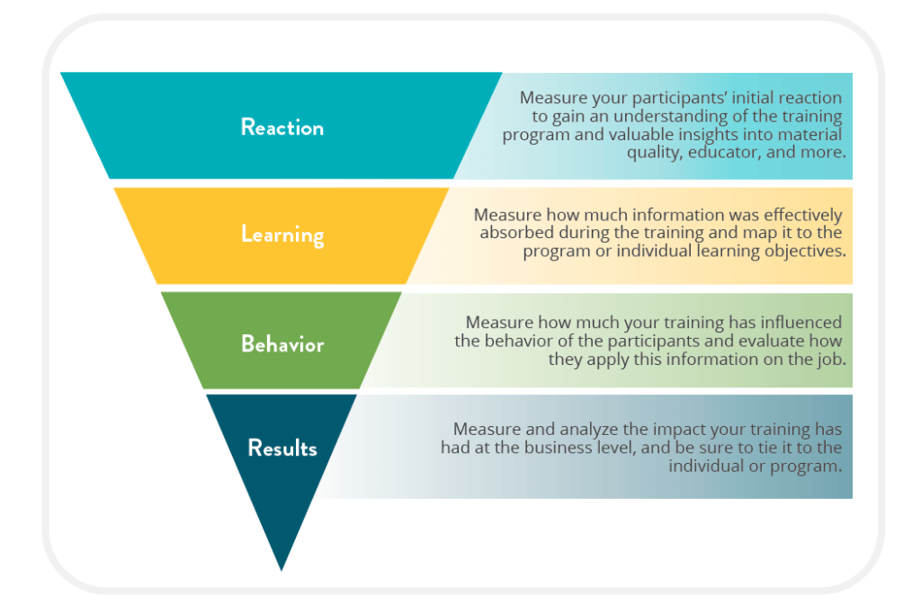
The Kirkpatrick Model

Slide 8
The ADDIE Model

Slide 9
Evaluation and Continuous Improvement
Question 1: How does Kirkpatrick’s Four-Level Model help educators evaluate the effectiveness of eLearning programs?
Question 2: Examine the role of data analysis in assessing the impact of eLearning on performance. How can data driven insights help identify areas for improvement and inform decision-making in eLearning design and delivery?
Question 3: How does the analysis of eLearning assessment criteria contribute to ensuring the quality and relevance of course content, and what are some examples of criteria that can be utilized in evaluating eLearning materials?

Slide 10
Breakout Rooms

Slide 11
Thank You

