Slide 1


IQ_AI Activity
Copyright © Michael Quartermain, CC BY 4.0
Notes:
Introducing the basics of Artificial Intelligence is a crucial step in preparing students for a future where AI technologies play a significant role in daily life and work. Educators play a crucial role in demystifying AI, making it accessible and understandable for students of all ages.
Teaching AI literacy involves:
>Explaining fundamental AI concepts in an engaging and age-appropriate manner.
>Encouraging curiosity by using current course material as a basis for AI inquiry
>Fostering an understanding of both the potential benefits and ethical considerations of AI.
By integrating AI education into the curriculum, educators can help students develop a foundational understanding of AI, its inner workings, and its societal implications.

Slide 2
This activity is for you to identify concepts of interest and learn to research them using Microsoft Co-Pilot
LEARNING OBJECTIVES:
Apply Copilot to explore business concepts.
Design effective AI prompts.
Critically evaluate AI-generated outputs.
Reflect on learning and ethical use of generative tools.
Copyright © Michael Quartermain, CC BY 4.0
2
Notes:
AI offers a broad spectrum of capabilities that can enhance both teaching and learning experiences, making educational processes more efficient and adaptive to the needs of students and educators alike. The overall landscape of AI in education spans various dimensions, from administrative efficiency to instructional support, fundamentally reshaping traditional educational methodologies.

Slide 3



Watch for these icons
Information
Activity
Questions
Copyright © Michael Quartermain, CC BY 4.0
3
Copyright © Michael Quartermain, CC BY 4.0
Notes:
These icons are used throughout the presentation to highlight information being conveyed, activities and questions.

Slide 4


Have you used AI tools for assignments? How have you used AI?
POLL
Copyright © Michael Quartermain, CC BY 4.0
Notes:
Bridge in: Option of an open class discussion or opening a polling tool, such as Mentimeter. Instructors may need to set up the question in their own polling tool of choice

Slide 5


What is AI?
Copyright © Michael Quartermain, CC BY 4.0
5

Slide 6
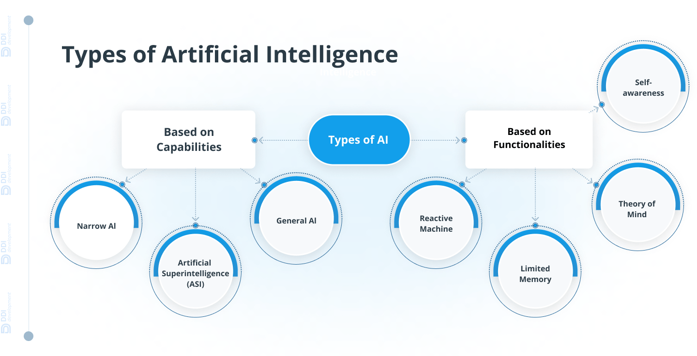
Types of Artificial Intelligence
Click on the image to go to the source for more information.
Our Focus
(DDI Development, 2024; Zewe, 2023).
6
Copyright © Michael Quartermain, CC BY 4.0
Notes:
There are many types of AI – this chart represents 5 of them- others may show anywhere from 3 – 7 types
Summary of the Seven Types of AI (from DDI Development)
The article categorizes AI into several types based on capabilities and functionality. Here are seven key types with brief descriptions:
1. Narrow AI (Weak AI)
Description: Specializes in one specific task, such as chatbots or recommendation systems.
Use Case: Customer service automation, product recommendations, and quality control in manufacturing.
2. General AI (Strong AI)
Description: Hypothetical AI that can perform any intellectual task a human can do.
Use Case: Advanced problem-solving across domains like supply chain optimization and drug discovery.
3. Artificial Superintelligence (ASI)
Description: A theoretical AI surpassing human intelligence in all aspects.
Use Case: Could revolutionize science, healthcare, and global challenges like climate change (still conceptual).
4. Reactive Machines
Description: Basic AI systems that react to current inputs without memory or learning.
Use Case: Chess programs, assembly-line robots.
5. Limited Memory AI
Description: Can use past data for short-term decisions.
Use Case: Self-driving cars, personalized recommendations.
6. Theory of Mind AI
Description: Future AI that understands emotions, beliefs, and intentions.
Use Case: Advanced social robots and empathetic customer service bots (still in development).
7. Self-Aware AI
Description: Hypothetical AI with consciousness and self-awareness.
Use Case: No real-world examples yet; remains speculative.

Slide 7
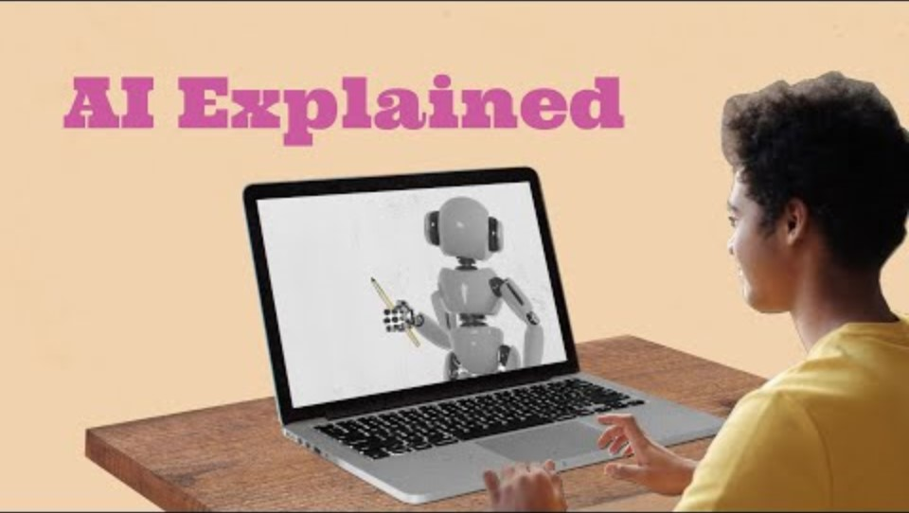
AI Explained
Source: Common Sense Education. (2023, September 22). What is AI? [Video]. YouTube.
7
Copyright © Michael Quartermain, CC BY 4.0
Notes:
Common Sense Education. (2023). What is AI? [Online video]. YouTube.

Slide 8


What is Microsoft Co-Pilot
Copilot is an advanced AI assistant designed to help you with a wide range of tasks, from answering questions to providing support with your studies. It’s like having a knowledgeable friend who can assist you anytime!
(Microsoft, 2023).
8
Copyright © Michael Quartermain, CC BY 4.0

Slide 9

Microsoft 365
Microsoft 365
Source: Microsoft 365. (2023, March 16). Introducing Microsoft 365 Copilot | Your copilot for work [Video]. YouTube.
Copyright © Michael Quartermain, CC BY 4.0
Notes:
https://www.youtube.com/watch?v=S7xTBa93TX8

Slide 10
Students and employees have access to Microsoft Copilot as part of Conestoga’s institutional Microsoft Office license.
Copyright © Michael Quartermain, CC BY 4.0
10
Notes:
NOTE: This slide can be updated with the appropriate institutional guideline or hidden if not applicable
Generative AI Toolkit – Copilot Announcement to Students:
Key Messages for Faculty
1. Students have access to Microsoft Copilot as part of Conestoga’s institutional Microsoft Office license.
2. Students should always confirm with you first, if and when, they are able to use generative AI in the course you are teaching. If they use it and it is not permitted, this is considered a violation of our Academic Integrity Policy.
3. When permitted, students need to reflect the values of safe usage, integrity, and transparency.
4. Students can visit the Generative AI Toolkit created by the Library and Learning Services team to learn more about Copilot and Gen AI: Home - Gen AI for Students - Library & Learning Services at Conestoga College
5. If you are permitting / encouraging students to use generative AI in your course, request that they use Microsoft Copilot since it is part of the institutional license that Conestoga has with Microsoft.
6. By using Copilot with their Conestoga-issued email creden􀆟als, students are working in a protected environment which means that none of the information shared in the chat is stored or used to train AI models. Neither Conestoga, nor Microsoft, can access or use the data in any way.
7. If students need any assistance or have any questions about their program or the services and supports available to them at Conestoga, they can visit the Student Success Services portal.

Slide 11
Always confirm with your instructor if and when you are permitted to use Copilot in this course.
If you use it when it is not permitted, this will be considered a violation of our Academic Integrity policies.
Copyright © Michael Quartermain, CC BY 4.0
11

Slide 12

Use Edge to access Copilot
Alternate: https://www.perplexity.ai
Copyright © Michael Quartermain, CC BY 4.0
12
Notes:
It is recommended that students use Microsoft Edge browser to access the college version of the tool.
Authentication may be required.
If this is an issue, alternatively, students can access https://www.perplexity.ai
Finally, as an opt out, if students are not comfortable with using an AI tool then they can default to use google searches.

Slide 13

AI Guiding Principles
SAFE USAGE:
Copilot is a protected environment.
INTEGRITY:
Use Copilot only when permitted.
TRANSPARENCY:
Acknowledge when you use Copilot.
“Microsoft. (2024). MS Copilot (February 20,2024 version)
[Large Language Model]. https://copilot.microsoft.com/.”
The in-text citation is “(Microsoft, 2024)”
Copyright © Michael Quartermain, CC BY 4.0
13

Slide 14

There are three parts to the activity: Part 1 – IQ Part 2 – Co-Pilot Part 3 – Critical Output Reflection
(Kramer, 2022)
14
Copyright © Michael Quartermain, CC BY 4.0
Notes:
Kramer, P. (2022) 10 Creative Ways to Better Engage Your Students: Remember, Telling Is Not Teaching
https://hbsp.harvard.edu/inspiring-minds/10-creative-ways-to-better-engage-your-students

Slide 15

This IQ activity is to build your skills and knowledge in using Microsoft Co-Pilot
Record your information on the Word.docx template provided in the course shell:
Three interests
Your question
Your prompts used
Your personal reflection
(Kramer, 2022)
15
Copyright © Michael Quartermain, CC BY 4.0

Slide 16

Part 1 – IQ
Part 1 - IQ (Interests & Questions)
IQ cards provide an interesting and efficient way for you to deepen insights about what you have learned, as well as raise questions after a lecture or class activity.
Write three areas of interest (representing the “I” in IQ) based on the material covered to date in the course.
From the three areas of interest, you will write a question (Q) that you have about the information.
The outcome is to have you critically think about the course in an informal assessment of your learning and review key lesson content, which helps me assess whether you are grasping the material.
(Kramer, 2022)
16
Copyright © Michael Quartermain, CC BY 4.0
Notes:
IQ Cards
IQ cards provide an interesting and efficient way for students to share insights about what they have learned, as well as raise questions after a lecture or class activity. Students write an insight (representing the “I” in IQ) on one side of an index card. This insight can be related to something new they learned during that class, or it can be a “so what” statement, indicating how this information can be applied in professional or personal practice.
On the other side of the card, the students write a question (Q) that they have about the information. Typically, I like to have students share their cards with their peers in pairs and then I collect the cards to gather informal assessment data about student learning. This works as an excellent closure activity as it reviews key lesson content and helps me assess whether students are grasping the material.

Slide 17
Part 1 – IQ Interests
INTEREST (I)
Review the course key concepts and theories we have covered to date and identify three (3) that are of interest to you and record them on the assignment template.
(Kramer, 2022)
17
Copyright © Michael Quartermain, CC BY 4.0

Slide 18
Part 1 – IQ Interests
INTEREST (I)
<INSERT RELEVANT COURSE TOPICS FOR STUDENTS TO USE FOR AI INQUIRY>
(Kramer, 2022)
18
Copyright © Michael Quartermain, CC BY 4.0

Slide 19
Part 1 – IQ Question
QUESTION (Q)
Based on the three (3) course key concepts and you identified which one of them is of the most interest to do more research on – what question would you want to ask - record your choice on the assignment template.
(Kramer, 2022)
19
Copyright © Michael Quartermain, CC BY 4.0

Slide 20

Part 1 – IQ Question
(Kramer, 2022)
20
Copyright © Michael Quartermain, CC BY 4.0

Slide 21


Part 2 –Researching your question using Co-Pilot – Prompt Engineering
Copyright © Michael Quartermain, CC BY 4.0
21

Slide 22
Prompt Engineering
Generative AI
Generative AI can be thought of as a machine-learning model that is trained to create new data, rather than making a prediction about a specific dataset.
Generative AI can inherit and proliferate biases that exist in training data or amplify hate speech and false statements.
The models have the capacity to plagiarize and can generate content that looks like it was produced by a specific human creator, raising potential copyright issues.
(Crabtree, 2024).
22
Copyright © Michael Quartermain, CC BY 4.0
Notes:
Our focus is GEN AI

Slide 23
Prompt Engineering
Input and Output
Gen-AI systems are often prompted with natural language from a human, which can be text or voice, or copied text from elsewhere.
From these inputs (prompts) Gen-AI systems generate new content that resembles what they have learned. This could be text, images, videos, music, or code.
(Crabtree, 2024).
23
Copyright © Michael Quartermain, CC BY 4.0
Notes:
Our focus is GEN AI

Slide 24
Prompt Engineering
Developing a Prompt to use around your question
A prompt is a set of instructions used to ask an AI tool to perform a task and produce an output. The more specific, explicit, and concise the instructions are, the more successful the resulting outputs will be.
(Crabtree, 2024).
24
Copyright © Michael Quartermain, CC BY 4.0

Slide 25
Prompt Engineering
Tips for Successful Prompts
A successful prompt (Crabtree, 2024) is comprised of several characteristics:
Instruction: Clear and explicit instructions tell the AI tool what action(s) you want it to perform.
Context: This information helps the AI tool understand your request's broader scenario or background and helps better tailor and frame its response.
Input data: data is the information you provide to the AI tool for processing. It could be a paragraph or a set of numbers, for example.
Output indicator: This part of your prompt tells the AI tool how to respond to your request. It might be a stylistic direction or citation style, for example.
(Crabtree, 2024).
25
Copyright © Michael Quartermain, CC BY 4.0
Notes:
bit.ly/AIPromptLibrary – AI prompt library

Slide 26
Part 2 – Co-Pilot – Develop a Prompt
Develop a Prompt to use around your question.
Ask Copilot how it can specifically help with your question.
It provides custom insights tailored to your individual question.
For those new to large language models (LLMs), experimenting with Copilot is great practice. You can learn how to maximize generative AI by exploring different prompts.
(Crabtree, 2024).
26
Copyright © Michael Quartermain, CC BY 4.0

Slide 27
Part 2 – Co-Pilot Prompt Examples
Prompt Examples _ Action Stems
Can you write/explain/ summarize/ provide/analyze/compose / re-write /translate ...
Give me a table summarizing some of the key differences between ... and ...
Rephrase this sentence: ..... / Expand the idea based on the following descriptors .....
(Crabtree, 2024).
27
Copyright © Michael Quartermain, CC BY 4.0

Slide 28

Part 2 – Co-Pilot Prompt Development 1) – pair & share
From prompt stems – can you develop a prompt that would answer your question?
Work in pairs and share ideas on prompts
Record your prompt on the template
Record your prompt response
Reflect on your prompt answer to your question, considering the quality of the answer and sources
Record your analysis
Copyright © Michael Quartermain, CC BY 4.0
28
Notes:
Work in pairs to discuss how you might develop a prompt – share your ideas and test your prompt using your question as the base.

Slide 29

Output Co-Pilot Prompts – record your prompts & answers
Copy and record your prompts and responses in the Word.docx. Template provided.
Copyright © Michael Quartermain, CC BY 4.0
29

Slide 30
Part 2 – Co-Pilot Prompts
Copyright © Michael Quartermain, CC BY 4.0
30

Slide 31
Part 2 – Co-Pilot Prompt 2) Compare – copy and use this prompt and compare the output to your first prompt
Concept/Theory: [Insert Concept/Theory Name]
Overview: Provide a brief overview of the concept/theory. Explain its significance in strategic management and how it is applied in business contexts.
Additional Information: What are the key components or elements of this concept/theory? How does it integrate with other strategic management frameworks or models?
Alternate Views: Discuss any alternate views or criticisms of this concept/theory. Are there any limitations or challenges associated with its application?
Current Business Examples: Provide examples of current businesses or industries where this concept/theory is being applied. How are these businesses leveraging this concept/theory to gain a competitive advantage?
References: Include references to academic articles, case studies, or other credible sources that provide further information on this concept/theory.
Copyright © Michael Quartermain, CC BY 4.0
31
Notes:
Use this prompt and compare the output to the response you received from your prompt.

Slide 32
Output Co-Pilot Prompts – record your prompts & answers
Copy and record your prompts and responses in the Word.docx. Template provided.
Copyright © Michael Quartermain, CC BY 4.0
32

Slide 33
Sample output using this prompt Concept/Theory: Porter's Five Forces Model Overview: Porter's Five Forces Model is a framework for analyzing the competitive forces within an industry. It helps businesses understand the intensity of competition and the profitability potential of an industry. The five forces include the threat of new entrants, the bargaining power of suppliers, the bargaining power of buyers, the threat of substitute products or services, and the intensity of competitive rivalry. Additional Information: The model emphasizes the importance of understanding the external environment and how these forces impact strategic decision-making. It integrates with other strategic management frameworks such as SWOT analysis and PESTEL analysis. Alternate Views: Critics argue that Porter's Five Forces Model may oversimplify the complexities of modern industries, especially in rapidly changing markets. Additionally, it may not fully account for the impact of digital transformation and globalization. Current Business Examples: In the tech industry, companies like Apple and Google use Porter's Five Forces to assess competitive pressures and inform their strategic initiatives. For instance, Apple analyzes the bargaining power of suppliers to negotiate better terms and maintain its competitive edge. References: - Rothaermel, F. T. (2021). Strategic Management (6th ed.). McGraw-Hill Education. - Porter, M. E. (1979). How Competitive Forces Shape Strategy. Harvard Business Review. - Case Study: Apple's Strategic Management Practices. (2023). Business Strategy Journal. Source: Conversation with Copilot, 9/30/2024 (1) undefined. https://bing.com/search?q=. (2) undefined. https://hbsp.harvard.edu/inspiring-minds/10-creative-. (Microsoft, 2024)
Copyright © Michael Quartermain, CC BY 4.0
Notes:
This is a response to the structured prompt provided.

Slide 34
Part 2 – Co-Pilot Prompts – compare and refine your prompt question
After comparing the two prompts, would you make any refinements to improve your response?
Apply the criteria of
Is the information/source real
Is the source relevant
Did Copilot accurately interpret the source material
Collect effective prompts in your Word.docx template
Copyright © Michael Quartermain, CC BY 4.0
34

Slide 35
Part 2 – make sure you have recorded your prompts and responses – you should have two!
Copyright © Michael Quartermain, CC BY 4.0
35

Slide 36

Part 3 – Output Validation, Reflection and Critical Analysis
Copyright © Michael Quartermain, CC BY 4.0
36

Slide 37
What Are AI Hallucinations?
AI hallucinations occur when generative AI tools produce outputs that are factually incorrect, fabricated, or misleading.
Caused by pattern-based generation without real-world understanding or fact-checking.
Examples include fake academic references, misquoted statistics, or incorrect definitions.
Students may unknowingly use false information in assignments.
Always verify AI-generated content using trusted sources and academic databases.
(Alison, n.d.).
37
Copyright © Michael Quartermain, CC BY 4.0

Slide 38
Recognizing Bias in AI Outputs
Sources of AI Bias
Bias arises from training data, algorithm design, and societal context influencing AI outputs.
Evaluating Disparate Impact
Assess AI decisions for disproportionate effects on groups based on race, gender, or age.
Cross-Referencing Outputs
Compare AI-generated content with real-world data and trusted sources for accuracy.
Monitoring Representation
Check for lack of diversity in AI outputs to detect hidden biases in data or models.
(Alison, n.d.).
Copyright © Michael Quartermain, CC BY 4.0
Notes:
Recognizing bias in AI outputs is an essential step in mitigating its impact and ensuring AI systems are used responsibly. As AI technologies become increasingly integrated into decision-making processes across sectors such as education, healthcare, finance, and law enforcement, the potential for biased outcomes grows. These biases can stem from the data used to train models, the design of algorithms, and the societal contexts in which AI is deployed. To address this, users and developers must adopt strategies that help identify and reduce bias in AI-generated content. One effective strategy is to evaluate outputs for disparate impact, which involves assessing whether the AI's decisions disproportionately affect certain groups based on race, gender, age, or other characteristics. This can reveal hidden patterns of discrimination that may not be immediately apparent. Another approach is to cross-reference AI outputs with real-world data and established knowledge. By comparing AI-generated information with verified sources, users can detect inaccuracies and ensure the reliability of the content. Additionally, comparing outputs across different demographics can help identify inconsistencies and potential biases. For example, if an AI tool provides different recommendations for similar individuals based solely on demographic factors, this may indicate a biased algorithm. Monitoring for the absence of diversity in AI outputs is also crucial. A lack of representation in generated content or decisions may signal underlying bias in the training data or model design. Finally, seeking external validation from independent, reputable sources can help confirm the accuracy and fairness of AI outputs. This includes consulting academic literature, expert opinions, and trusted databases. By implementing these strategies, users can foster a more ethical and equitable use of AI technologies, promoting transparency and accountability in AI-driven systems.

Slide 39

Part 3 – Output Co-Pilot Prompts – validate your references & sources
Validate any references provided by Co-pilot by clicking on links and then provide a proper APA@ Conestoga citation
Copyright © Michael Quartermain, CC BY 4.0
39

Slide 40
Part 3 – Reflection - reflect on your experience and key learnings
Reflect on the output from Copilot:
What is your assessment of the output
Compare the output to your text – same, different – correct, incorrect
What did you learn from this exercise?
Copyright © Michael Quartermain, CC BY 4.0
40

Slide 41
Submit your Word.docx to the activity dropbox
Your final submission will include:
Interests – three (3) concepts or theories you selected
Question – selected to use in your AI prompt
Your prompt (s) plus output
Validation of References by converting to APA@Conestoga format
Your reflection
Copyright © Michael Quartermain, CC BY 4.0
41

Slide 42
Gen AI Toolkit
The Library and Learning Services team have created a website where you can learn more about Copilot and how to use it safely, with integrity, and transparency.
Copyright © Michael Quartermain, CC BY 4.0
42
Notes:
For instructors.

Slide 43
Want to learn more or earn a certificate
Gen AI for Students
Library & Learning Services_Gen AI for Students’ Home
https://lib.conestogac.on.ca/genai
Get Started with Microsoft Copilot - Learning Path on LinkedIn Learning and earn a certificate of completion.
Get Started with Microsoft Copilot
Copyright © Michael Quartermain, CC BY 4.0
43

Slide 44
Want to learn even more!
eCampusOntario AI in Education Consortium,
Canadian Digital Learning Research Association survey on Digital Learning & AI
CIFAR Pan-Canadian AI Strategy,
Institutional task forces at University of British Columbia (UBC)
Institutional task force at Toronto Metropolitan University (TMU).
Copyright © Michael Quartermain, CC BY 4.0
44

Slide 45

References
Alison. (n.d.). Artificial intelligence in higher education. Alison. https://alison.com/
Crabtree, M. (2024). What is prompt engineering? A detailed guide for 2024.Datacamp. https://www.datacamp.com/blog/what-is-prompt-engineering-the-future-of-ai-communication
Common Sense Education. (2023). What is AI? [Online video]. YouTube. https://youtu.be/b0KaGBOU4Ys
DDI Development. (2024). Types of AI that can drive your business growth. DDI Development. https://ddi-dev.com/blog/it-news/types-of-ai-that-can-drive-your-business-growth/
Kramer, P. (2022) 10 Creative Ways to Better Engage Your Students: Remember, Telling Is Not Teaching
https://hbsp.harvard.edu/inspiring-minds/10-creative-ways-to-better-engage-your-students
Microsoft. (2023). Introducing Microsoft 365 Copilot | Your Copilot for Work [Video]. YouTube. https://www.youtube.com/watch?v=S7xTBa93TX8
Zewe, A. (2023). Explained: generative AI. MIT News. https://news.mit.edu/2023/explained-generative-ai-1109.
Copyright © Michael Quartermain, CC BY 4.0
45

Slide 46
Credits & Attributions
This presentation was created by Michael Quartermain and is made available by Conestoga Open Learning under a Creative Commons Attribution (CC BY) license.
Unless otherwise noted, all photos, icons, and illustrations included in this presentation are sourced from the Microsoft PowerPoint Stock Images library. These elements are subject to Microsoft’s licensing terms and are not covered by the CC BY license. They may not be reused, redistributed, or modified outside of PowerPoint slides or other Microsoft products without permission from Microsoft.
The Conestoga College logo is © All Rights Reserved and may not be used outside of this presentation without permission from the college.
Copyright © Michael Quartermain, CC BY 4.0
46

